Slide 1



Automated
Image Generation
Hill Seah Wen Qi (U2121346H)
Project ID
Project Supervisor
CCDS24-0163
Associate Professor Lu Shijian
Examiner
Associate Professor Lin Guosheng

Slide 2



Outline
Research Scope
Introduction
Motivation
Objectives

Slide 3



Research Scope
FYP Title ⟶ FYP Research Scope
Automated ⟶ Training-Free
Automated Generation implies minimal human input
Chosen training-free methods
Training-free take automation further by removing the need for retraining on new data or conditions
This increases practicality, reduces computational costs, and supports rapid adaptation to new generation tasks

Slide 4

Research Scope
FYP Title ⟶ FYP Research Scope
Image Generation ⟶ Multi-conditional Image Generation (Diffusion Models)
Chosen multi-conditional generation, where multiple attributes or conditions guide the image output
Chosen diffusion models as the primary image generation network as they offer strong controllability and high image quality
Potential improvements or enhancements to existing problems and pain points

Slide 5



Motivation
Relevance of Training-Free Multi-Conditional Generation
“Generative design and content creation have the potential to unlock $150 billion to $275 billion in new value across industries like marketing, gaming, architecture, and product design.”
- McKinsey & Company, 2023
“Generative models like Stable Diffusion have sparked a dramatic rise in visual content creation, with over 10 million images generated daily by users worldwide.”
- Stanford University, 2024
Stable Diffusion 2.0
Training from scratch required approximately 150,000 GPU-hours using 256 NVIDIA A100 GPUs, culminating in a cost of around $600,000.

Slide 6



Motivation
Challenges of Training-Free Multi-Conditional Generation
Independent Condition Optimization
Conflicting Guidance Signals
Lack of Joint Condition Satisfaction
Most methods optimize each condition separately, assuming independence — this neglects semantic interactions, leading to incoherent or conflicting outputs [6]
Without a learned fusion mechanism, different conditions may pull the generation in different directions, degrading
visual fidelity [8]
Existing methods struggle to enforce joint constraint satisfaction, especially when conditions interact non-trivially [21]

Slide 7


Objectives
Create a flexible base solution for training-free multi conditional image generation
Base solution should be able to handle multiple conditions and remain training-free even when new conditions are added
Base solution should be flexible and open to enhancements (for example in Objective 2)
Solve the problem of the lack of handling of complicated and non-linear interactions between multiple potentially dependent conditions

Slide 8


Outline
Conditional Score Based Diffusion Models
Literature Review
Energy Diffusion Guidance
Approximating Time-Dependent Energy Guidance with Time-Independent Distance Functions

Slide 9
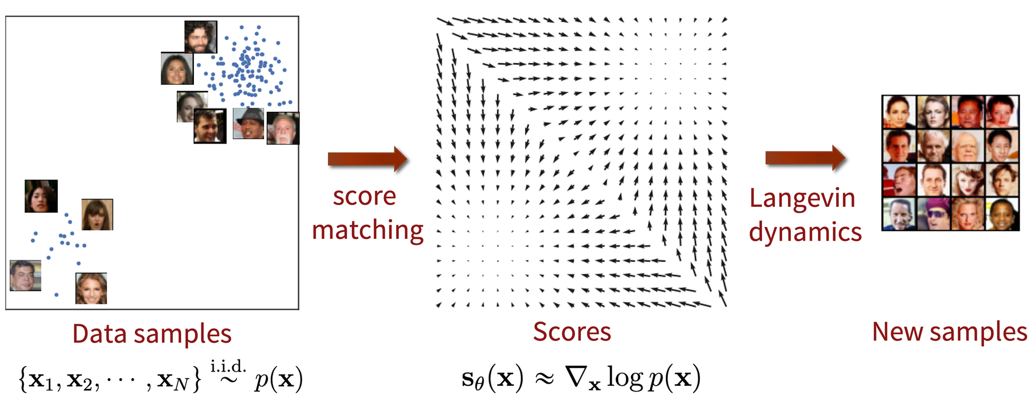
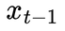

Conditional Score Based Diffusion Models
Unconditional Score-Based Diffusion Models (USBDM)
Operates on score theory
Learn and estimate a time-dependent score function that guides the denoising phase of a noisy image to at time step t during the iterative denoising process [16]
Denoising Formula
Score Function

Slide 10


Conditional Score Based Diffusion Models
Conditional Score-Based Diffusion Models (CSBDM)
A corrective gradient is added to the USBDM denoising formula
The corrective gradient guides to a hyperplane in the data space that aligns with the condition c [16]
Denoising Formula
Corrective Gradient

Slide 11
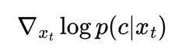
Conditional Score Based Diffusion Models
Training-Required VS Training-Free Methods
To obtain the conditional corrective gradient
Training-Required
Training-Free Methods
Often retain the time-dependent nature of the conditional corrective gradient
Learn it through approaches like classifier training
With each new condition, retraining will be required to learn a new corrective gradient
Conditional information is integrated during the training phase
In contrast, often aim to approximate the corrective gradient using time-independent functions
With each new condition, retraining is not required
Conditional information is incorporated only during inference (denoising)

Slide 12


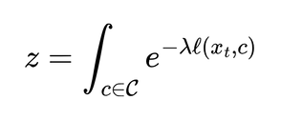

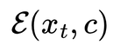
Energy Diffusion Guidance
Definition of Energy Diffusion Guidance
[9]
Where
represents the normalizing constant,
λ represents the temperature
represents the energy function measuring the similarity between a given
condition c and a noisy image

Slide 13
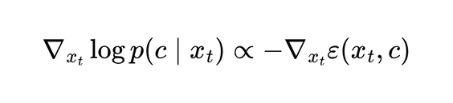

Energy Diffusion Guidance
Alternative method to model the conditional corrective gradient
Energy function value decreases as the similarity between and c increases
Energy function = zero when and c are perfectly similar
Thus, the corrective gradient can be remodelled to energy guidance as
[9]
Final denoising formula with energy diffusion guidance

Slide 14
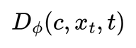
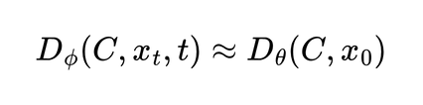
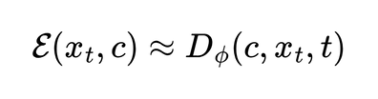
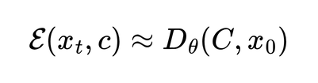
Approximating Time-Dependent Energy Guidance with Time-Independent Distance Functions
Training-Required Methods
Training-Free Methods
Most train classifiers to calculate a Time-Dependent Distance Function between and c
Time-dependent Distance Function then used to approximate the energy guidance function
Approximate the Time-Dependent Distance Function with Time-Independent Distance Functions
Time-Independent Distance Function then used to approximate the energy guidance function
where ϕ represents the trained parameters of the classifier [5]
where θ represents the parameters of a pre-trained classifier [20]

Slide 15



Outline
MATCHE Diffusion
Solutions
Multi-Conditional Time-Independent Approximated Energy Guidance
Approximating Clean Image from Noisy Image
Interaction Modelling

Slide 16


Solutions Overview
Unanswered Problems?
How do we use energy-based guidance to build a flexible base mutli-conditional training-free denoising process?
If we were to use the time-independent approximation of energy-based guidance for the training-free denosing process, how do we get the required clean image from noisy image at each time step t ?
How do we solve the common problem of training-free image generation approaches - lack of handling complicated interactions between multiple potentially dependent conditions?

Slide 17


Solutions Overview
MATCHE Diffusion
Multi-conditional
Approximated
Time-independent
Condition-Harmonizing
Energy guidance

Slide 18
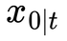
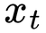
MATCHE DIFFUSION
Multi-conditional Approximated Time-independent Condition-Harmonizing Energy guidance
Main components
Multi-Conditional Approximated Time-Independent Energy Guidance
Base denoising process supporting multiple conditions, while remaining training free
Flexible to enhancements
Clean Image Approximation
Approximation of clean image from noisy image
Interaction Modelling (Condition Harmonizing)
Captures complex, non-linear interdependencies between conditions

Slide 19


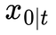

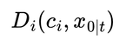
Multi-Conditional Time-Independent Approximated Energy Guidance
No Interaction Modelling
Definition
Example
If represents a text condition, then the pre-trained network i
could be a CLIP embedding model, and could be a Euclidean
distance value between the CLIP embedding of and
Where
represents a given condition i
represents the approximated clean image at time step t
represents the distance between condition i and
computed by a pre-trained network that is specific to condition i
λi represents the weighting factor of

Slide 20


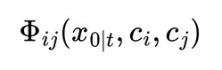
Multi-Conditional Time-Independent Approximated Energy Guidance
With Interaction Modelling
Definition
Where
represents a function that models the interactions
between conditions , and the approximated clean image
in their respective spaces
λij represents the weighting factor of

Slide 21


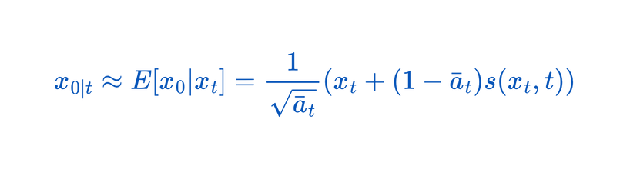
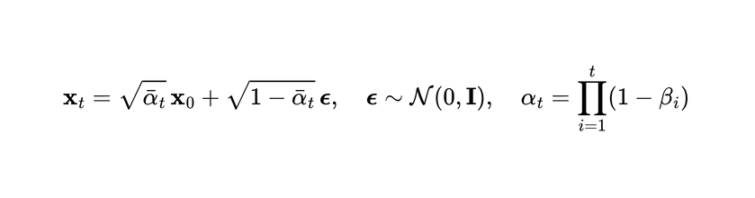

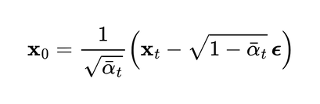
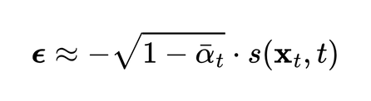
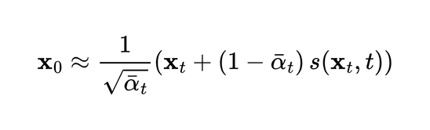

Approximating Clean Image from Noisy Image
Forward Process (Gaussian Noise Addition)
Rearranging to Estimate X0
Since the score-based diffusion model, s(, t) learns to predict ϵ, or its scaled version
Sub (3) in (2)

Slide 22


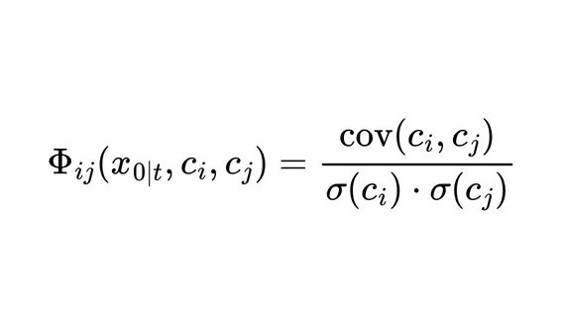
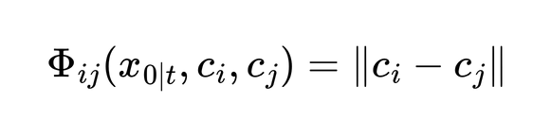
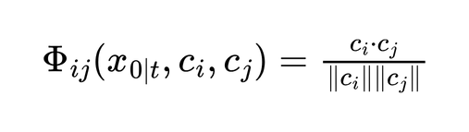
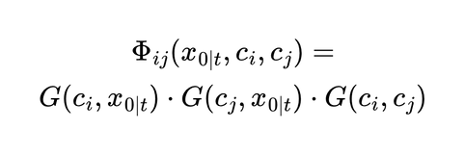
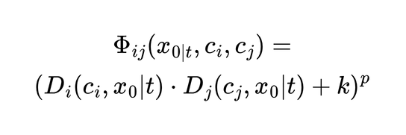
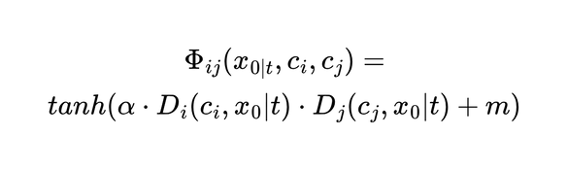
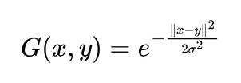
Interaction Modelling
Modelling
in
Euclidean Distance
Cosine Similarity
Pearson Correlation
Polynomial Kernel
Sigmoid Kernel
Gaussian Kernel
where

Slide 23
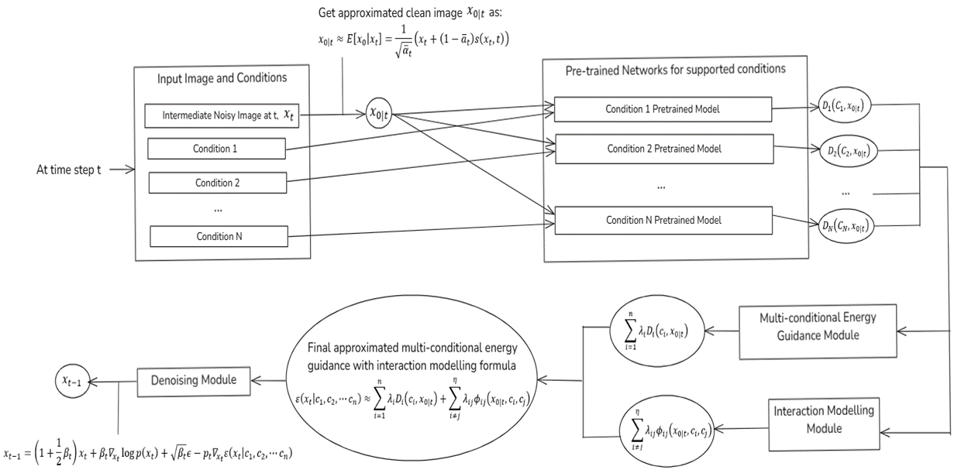
MATCHE Architecture

Slide 24




Outline
Scope
Experimental Setup
Configuration
Experiment Setup
Hyperparameter Optimisation

Slide 25
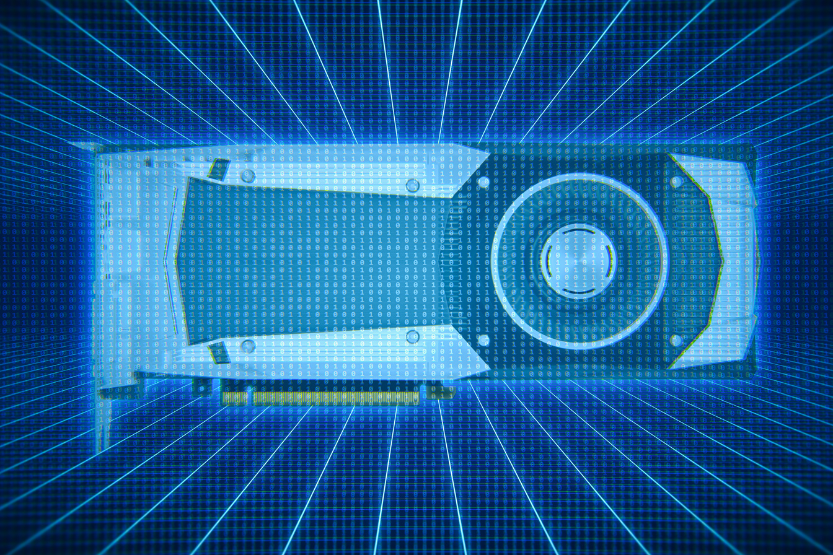
Scope
Image Generation Model
Limitations
Given GPU memory constraints, running larger diffusion models with general image generation capabilities (such as Stable Diffusion or ControlNet) was infeasible
These models require substantial Video Random-Access Memory (VRAM) to store high-dimensional tensors during the iterative denoising process, leading to out-of-memory errors on my available hardware
My NVIDIA GeForce GTX 1660 Ti has 6GB of VRAM, Stable Diffusion and ControlNet requires 8-12GB of VRAM
Chosen Model
Pre-trained unconditional human face diffusion model

Slide 26
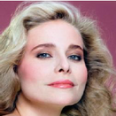

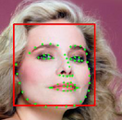
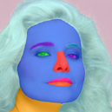
Scope
Conditions (Specific to facial image generation)
Condition | Description | Illustration
Face ID | Encodes identity-specific facial features in a numerical representation, ensuring consistency in facial appearance
Sketch | Provides a structural outline of the subject, capturing overall shape and contours.
Landmark | Defines spatial key points (e.g., eyes, nose, mouth) to enforce geometric accuracy in facial features
Segmentation Map | Specifies region-based attributes, guiding the model in differentiating facial parts and background elements
Text | Textual prompt that offers high-level semantic descriptions, providing flexible and interpretable guidance for image generation
Text Prompt
= “Wearing Lipstick”

Slide 27

Configuration
Image Generation Model
Unconditional Human Face Diffusion Model [25].
Supports image resolution of 256×256
Pre-trained on human faces in the CelebA-HQ dataset

Slide 28

Configuration
Condition-specific pre-trained model
Condition, ci | Model, fi(x) | Distance i ()
Face ID | Open-source Human Face Identification Network, ArcFace [4] | Euclidean Distance
Sketch | Open-source Sketch-to-Photo Synthesis Network [18] | Euclidean Distance
Landmark | Open-source Landmark Extractor Network [2] | Euclidean Distance
Segmentation Map | Open-source Real-Time Semantic Segmentation Network BiSeNet [19] | Euclidean Distance
Text | Open-source CLIP Image and Text Encoder [12] | Euclidean Distance

Slide 29

Experimental Setup
Setup Parameters
Avoid combining conditions with same information
Generated 1000 images from each multi-condition group
(Face ID, Landmark, Text)
(Sketch, Landmark, Text)
(Face ID, Segmentation Map, Text)
(Sketch, Segmentation Map, Text)
Evaluation criterion
Average Condition-Specific Euclidean Distances
Average Fréchet Inception Distance (FID)

Slide 30
Hyperparameter Optimisation
Limitations
Due to GPU limitations which resulted in long image generation times, hyperparameter tuning was conducted using a grid search over a predefined set of values
This approach ensures a systematic exploration of key parameters while maintaining computational feasibility

Slide 31

Hyperparameter Optimisation
Search Space
Hyperparameter | Search Space | Description
λi | (By ratio, rij = λi / λij) 1, 10, 100, 1000 | Weighting Factor for Distance Terms
λij | (By ratio, ri1j1i2j2 = λi1j1 / λi2j2) 1, 10, 100, 1000 | Weighting Factor for Interaction Terms
p | 1, 2, 3, 4, 5 | Polynomial Degree for Polynomial Kernel
k | 0.5, 1, 5, 10, 15 | Constant for Polynomial Kernel
α | 0.05, 0.1, 0.5, 1, 2 | Scaling factor for Sigmoid Kernel
m | 0.5, 1, 5, 10, 15 | Constant for Sigmoid Kernel
σ | 0.5, 0.8, 1 | Standard deviation for Gaussian Kernel

Slide 32



Outline
Hyperparameters
Results
Quantitative Results
Qualitative Results

Slide 33
Hyperparameters
Grid Search Results
Hyperparameter | Value | Description
λi | λ {Text} : λ {Seg Map} : λ {Landmark} : λ{ID} : λ {Sketch} = 1000 : 1 : 1000 : 1000 : 10 | Weighting Factor for Distance Terms
λij | For all i, j, λij = 1 | Weighting Factor for Interaction Terms
p | 3 | Polynomial Degree for Polynomial Kernel
k | 1 | Constant for Polynomial Kernel
α | 1 | Scaling factor for Sigmoid Kernel
m | 1 | Constant for Sigmoid Kernel
σ | 0.5 | Standard deviation for Gaussian Kernel

Slide 34
Quantitative Results
Comparison between Interaction Models
 | Text | Text | Facial ID | Facial ID | Segmentation Map | Segmentation Map | Landmark | Landmark | Sketch | Sketch
Interaction Models | FID | Distance | FID | Distance | FID | Distance | FID | Distance | FID | Distance
MATCHE (No Interaction Modelling) | 113 | 21.8 | 158 | 84.1 | 129 | 2331 | 139 | 17.3 | 119 | 329
Euclidean Distance | 163 | 34.9 | 188 | 132 | 146 | 2737 | 136 | 18.9 | 129 | 368
Cosine Similarity | 130 | 24.6 | 144 | 73.5 | 118 | 2147 | 128 | 21.4 | 116 | 317
Pearson Correlation | 149 | 29.2 | 148 | 83.2 | 131 | 2722 | 141 | 16.1 | 131 | 396
Polynomial | 86.2 | 18.0 | 102 | 71.5 | 91.0 | 2174 | 95.3 | 15.3 | 91.4 | 293
Sigmoid | 102 | 21.7 | 118 | 68.4 | 101 | 2272 | 127 | 16.3 | 122 | 322
Gaussian | 74.2 | 13.4 | 86.3 | 58.7 | 77.5 | 1825 | 81.7 | 14.9 | 89.2 | 248

Slide 35
Quantitative Results
TediGAN Baseline Comparison
To further validate the effectiveness of MATCHE diffusion, we compared MATCHE diffusion with Gaussian Kernels, with the baseline model TediGAN.
TediGAN is a multi-modal image generation framework that enables text-guided synthesis through StyleGAN inversion and visual-linguistic similarity learning [17]
 | Text | Text | Facial ID | Facial ID | Segmentation Map | Segmentation Map | Landmark | Landmark | Sketch | Sketch
Interaction Models | FID | Distance | FID | Distance | FID | Distance | FID | Distance | FID | Distance
TediGAN [17] | 71.9 | 12.8 | 82.8 | 59.0 | 81.2 | 2073 | 87.0 | 19.4 | 89.2 | 248
MATCHE | 74.2 | 13.4 | 86.3 | 58.7 | 77.5 | 1825 | 79.7 | 14.9 | 98.2 | 288

Slide 36
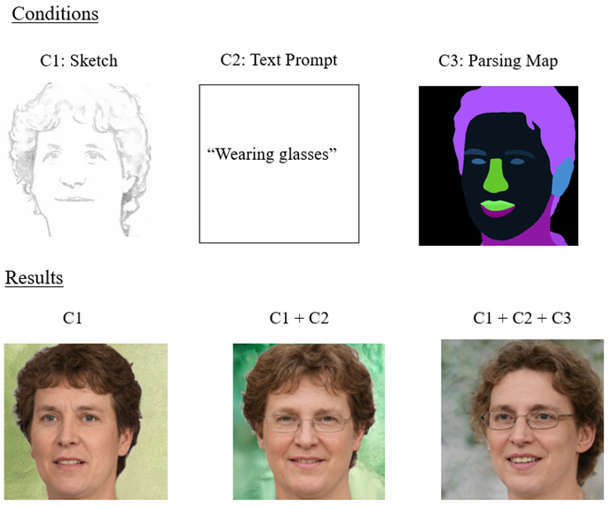
Qualitative Results
Illustration of Sequential Multi-Conditional Image Generation MATCHE Diffusion
Shows a sequence of image generation to better illustrates our model's ability to integrate multiple conditions progressively
In this example:
(Sketch → Sketch + Text Prompt → Sketch + Text Prompt + Segmentation Map)
This demonstrates how our proposed framework is able to add additional constraints and refine the output while preserving visual coherence

Slide 37
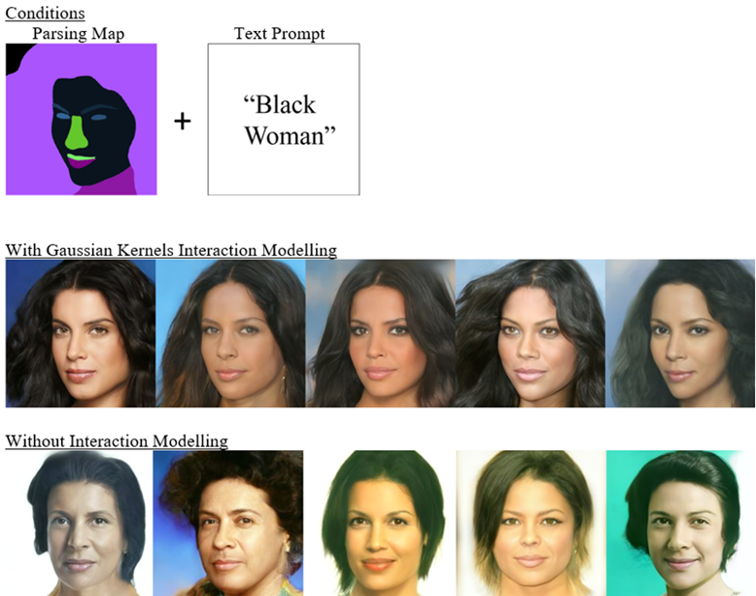
Qualitative Results
Segmentation Map + Text Prompt,
Multi-Conditional Image Generation Result

Slide 38
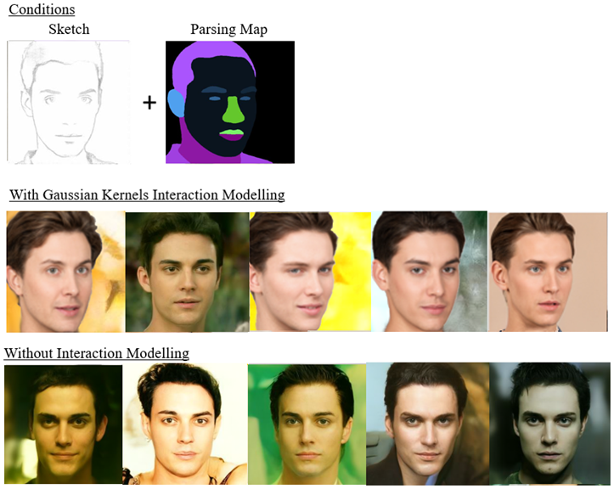
Qualitative Results
Sketch + Segmentation Map,
Multi-Conditional Image Generation Result

Slide 39
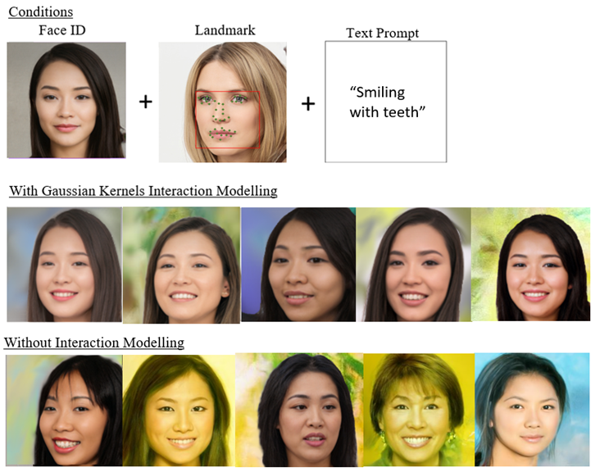
Qualitative Results
Face ID + Landmark + Text Prompt,
Multi-Conditional Image Generation Result

Slide 40
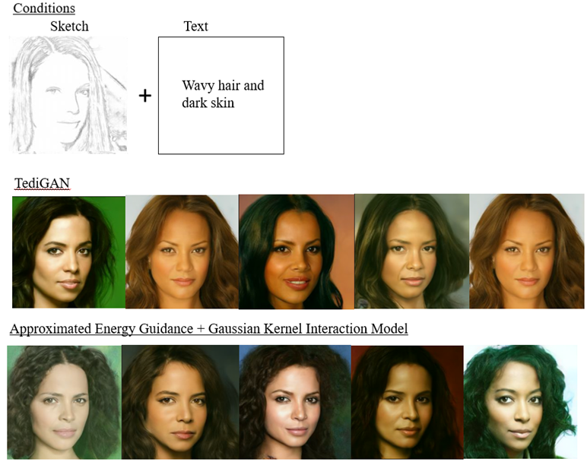
Qualitative Results
Baseline Comparison: Sketch + Text Prompt
MATCHE

Slide 41



Outline
Results Evaluation
Evaluation
Experimental Limitations
Future Work

Slide 42

Results Evaluation
Interation Modelling
Interaction modelling greatly improves quality of images
Seen from lower FID and improved visual fidelity
Appropriate interaction modelling is crucial, inappropriate modelling may result in worse results than no interaction modelling at all
Simple euclidean distance and cosine similarity generated worse results than base model with no interaction modelling
Baseline Comparison
Proposed method remains competitive with state-of-the-art networks like TediGAN
Highlights the incorporating MATCHE into existing training-free multi conditional methods to improve quality of outputs

Slide 43
Experimental Limitations
Model and Condition Scope
Given GPU memory constraints, running larger diffusion models with general image generation capabilities (such as Stable Diffusion or ControlNet) was infeasible
My NVIDIA GeForce GTX 1660 Ti has 6GB of VRAM, Stable Diffusion and ControlNet requires 8-12GB of VRAM
Thus, the model chosen was a smaller pre-trained unconditional face generation model
Consequently, the conditions tested were specific to facial images
However, the proposed time-independent training-free multi-conditional energy guidance framework is model and condition agnostic and thus the results remain translatatble to general image generation

Slide 44

Experimental Limitations
Hyperparameter Optimisation
Image generation process was highly time-intensive due to GPU resource constraints
Particularly when exploring multiple hyperparameter combinations.
Extremely high number of possible configurations for interaction model-specific hyperparameters, along with the weighting factors for each condition, was extremely large.
As a result, we acknowledge that our proposed grid search optimization method and the defined search space may not have been the most efficient approach for hyperparameter tuning.
Consequently, the results for the optimised parameters presented may not represent the most optimal settings.

Slide 45


Future Work
Anisotropic Gaussian Kernels
Standard Gaussian Kernel
Anisotropic Gaussian Kernel
σi is a fixed value, assumed to be fixed across all dimensions [13]
This is to reduce the hyperparameter search space to address GPU limitations and minimize computational complexity.
However, with the fixed σi, the standard Gaussian Kernel assumes equal influence in all directions, but some conditions (e.g., shape vs. color) influence different aspects of the image
Σ is a predefined diagonal covariance matrix with varying σi values based on the perpetual importance of the different dimensions [1]
This flexibility enables the kernel to capture the anisotropic nature of images, where different features (dimensions) may have different importance or units, requiring different levels of smoothness or variance along each axis [1]
Can potentially add improvements to shape, spatial, and color constraints by ensuring conditions affect only relevant aspects of image features

Slide 46
Future Work
Extensions to 3D Reconstruction
3D reconstruction can be viewed as generating a 3D representation X that best matches multiple observations or constraints.
With any 3D diffusion model, we can incorporate MATCHE into the denoising process as well
(e.g., voxel grid - 3D CNNs, GANs; point cloud - PointNet++)
MATCHE
Where
X: the reconstructed 3D object (e.g., voxel grid, mesh, point cloud)
ci​: different input conditions (e.g., RGB image, silhouette, multi-view images, depth, text)
Di: discrepancy function for each condition (e.g., perceptual distance between projected image and original)
Φij: interaction terms (e.g., consistency between silhouette and text, multi-view alignment)

Slide 47


Future Work
Extensions to Video Synthesis
Improved Spatial Energy Guidance
MATCHE can be adapted to energy guidance frame-by-frame in video synthesis
Enhance temporal smoothness by integrating interaction modelling
Modelling these interactions well can ensure smooth transitions, maintain motion coherence, and dynamic content effectively
Enable the generator to produce sequences where each frame is consistent with its neighbors, preserving the continuity and flow necessary for realistic video content

Slide 48
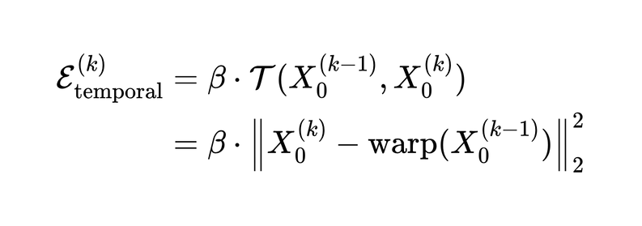
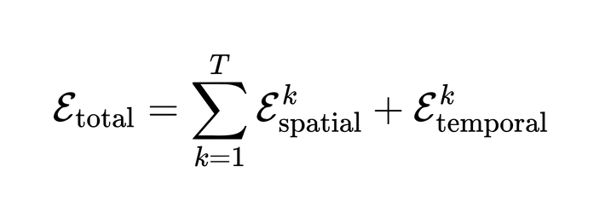
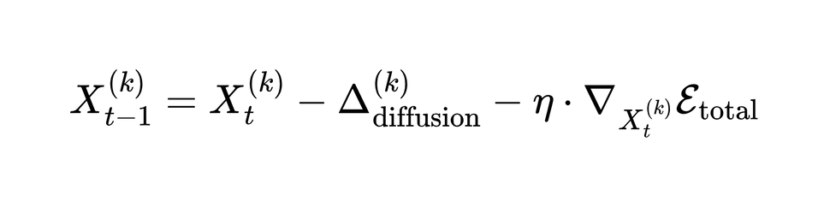
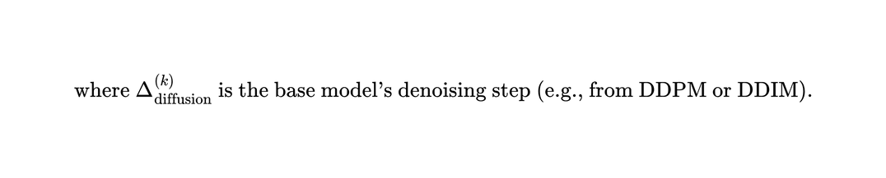
Future Work
Extensions to Video Synthesis
Temporal Energy Guidance (e.g. Optical flow warping loss)
Total Energy Guidance over the Video
Final Denoising Formula
[22]

Slide 49
Conclusion
Proposed Solution
Addressed Key Limitations
MATCHE
Multi-conditional Approximated Time-independent Condition-Harmonizing Energy guidance
Supports multiple conditions
Training-free
Condition harmonization - interaction modelling
Demonstrated Effectiveness
Acknowledged Limitations
Outperformed the TediGAN baseline in some conditions with notable improvements in both qualitative and quantitative metrics.
GPU constraints impacting hyperparameter tuning
Limits the experimental scope
Future Directions
Explore alternative kernel methods for better scaling
Extensions to other generative tasks
3D Reconstruction
Video Synthesis
This project lays a solid foundation for advancements in training-free multi-conditional image generation, opening avenues for more robust generative applications such as video synthesis and 3D reconstruction.

Slide 50
References

Slide 51
References
[1] Berry, T., and Sauer, T., 'Local kernels and the geometric structure of data', arXiv, https://doi.org/10.48550/arXiv.1407.1426, 2014.
[2] Chen, C., 'PyTorch Face Landmark: A fast and accurate facial landmark detector', github, https://github.com/cunjian/pytorch_face_landmark, 2021.
[3] Chung, H., Sim, B., and Ye, J. C., 'Come-closer-diffuse-faster: Accelerating conditional diffusion models for inverse problems through stochastic contraction', arXiv, https://doi.org/10.48550/arXiv.2112.05146, 2022.
[4] Deng, J., Guo, J., Xue, N., and Zafeiriou, S., 'Arcface: Additive angular margin loss for deep face recognition', arXiv, https://doi.org/10.48550/arXiv.1801.07698, 2019.
[5] Dhariwal, P., and Nichol, A., 'Diffusion models beat gans on image synthesis', arXiv, https://doi.org/10.48550/arXiv.2105.05233, 2021.
[6] Hertz, A., Mokady, R., Tenenbaum, J., Aberman, K., Pritch, Y., Cohen-Or, D., 'Prompt-to-Prompt Image Editing with Cross Attention Control', arXiv, https://doi.org/10.48550/arXiv.2208.01626, 2022
[7] Hofmann, T., Schölkopf, B., and Smola, A. J., 'Kernel methods in machine learning', arXiv, https://doi.org/10.48550/arXiv.math/0701907, 2008.
[8] Kim, G., Kwon, T., and Ye, J., 'DiffusionCLIP: Text-Guided Diffusion Models for Robust Image Manipulation', arXiv, https://doi.org/10.48550/arXiv.2110.02711, 2021
[9]LeCun, Y., Chopra, S., Hadsell, R., Ranzato, M., and Huang, F., 'A tutorial on energy-based learning', MIT Press, http://yann.lecun.com, 2006.
[10] Lin, H.-T., and Lin, C.-J., 'A study on sigmoid kernels for SVM and the training of non-PSD kernels by SMO-type methods', 2003
[11] Meng, C., He, Y., Song, Y., Song, J., Wu, J., Zhu, J.-Y., and Ermon, S., 'SDEdit: Guided image synthesis and editing with stochastic differential equations', arXiv, https://doi.org/10.48550/arXiv.2108.01073, 2022.

Slide 52
References
[12] Radford, A., Kim, J. W., Hallacy, C., Ramesh, A., Goh, G., Agarwal, S., Sastry, G., Askell, A., Mishkin, P., Clark, J., et al., 'Learning transferable visual models from natural language supervision', arXiv, https://doi.org/10.48550/arXiv.2103.00020, 2021.
[13] Rasmussen, C. E., and Williams, C. K. I., 'Gaussian processes for machine learning', MIT Press, https://doi.org/10.7551/mitpress/3206.001.0001, 2006.
[14] Schölkopf, B., & Smola, A. J., ‘Learning with kernels: Support Vector Machines, regularization, optimization, and beyond.’, MIT Press, https://doi.org/10.7551/mitpress/4175.001.0001, 2001
[15] Shawe-Taylor, J., and Cristianini, N., 'Kernel methods for pattern analysis', Cambridge University Press, https://doi.org/10.1017/CBO9780511809682, 2004.
[16] Song, Y., Sohl-Dickstein, J., Kingma, D. P., Kumar, A., Ermon, S., and Poole, B., 'Score-based generative modelling through stochastic differential equations', arXiv, https://doi.org/10.48550/arXiv.2011.13456, 2021.
[17] Xia, W., Yang, Y., Xue, J.-H., and Wu, B., 'TediGAN: Text-guided diverse face image generation and manipulation', arXiv, https://doi.org/10.48550/arXiv.2012.03308, 2021.
[18] Xiang, X., Liu, D., Yang, X., Zhu, Y., Shen, X., and Allebach, J. P, 'Adversarial open domain adaptation for sketch-to-photo synthesis', arXiv, https://doi.org/10.48550/arXiv.2104.05703, 2022.
[19] Yu, C., Wang, J., Peng, C., Gao, C., Yu, G., and Sang, N., 'Bisenet: Bilateral segmentation network for real-time semantic segmentation', arXiv, https://doi.org/10.48550/arXiv.1808.00897, 2018.
[20] Yu, J., Wang, Y., Zhao, C., Ghanem, B., and Zhang, J., 'FreeDoM: Training-free energy-guided conditional diffusion model', arXiv, https://doi.org/10.48550/arXiv.2303.09833, 2023.
[21] Zhang, L., Rao, A., Agrawala, M., 'Adding Conditional Control to Text-to-Image Diffusion Models', arXiv, https://doi.org/10.48550/arXiv.2302.05543, 2023.
[22] Zhang, Y., Zhao, D., Luo, Z., Chen, D., Huang, Y., Wang, L., Shen, Y., Zhou, J., Tan, T., 'VideoFusion: Decomposed Diffusion Models for High-Quality Video Generation', arXiv, https://doi.org/10.48550/arXiv.2302.05543, 2023.

Slide 53
Thank You!
Special thanks to my project supervisor, Professor Lu Shijian, and my student mentor, Xu Muyu, for their invaluable guidance and support throughout this journey!

Slide 54
Q&A

Slide 55
Appendix

Slide 56
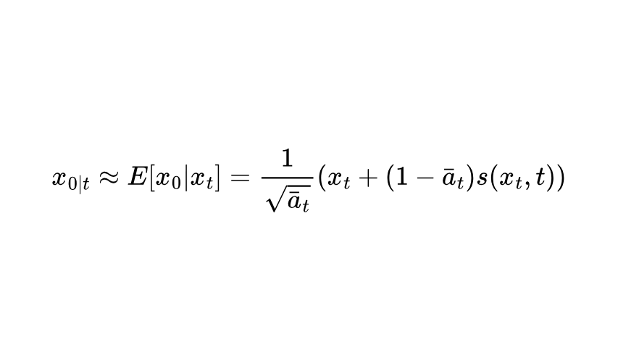
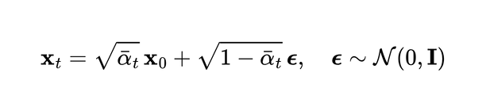
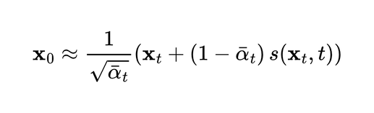
Appendix 1
Derivation of Approximating Clean Image X{0 | t} from Noisy Image X{t}
(1) Forward Process (Gaussian Noise Addition)
(2) Rearranging to Estimate X0
(3) Since the score-based diffusion model learns to predict ϵ, or its scaled version
(4) Sub (3) in (2)

Slide 57
Appendix 2
Experimental Setup - Multi-Conditional Groups Combination
Classified conditions into similar groups based on the type of information they provide
Group | Description | Conditions
Structural Representation | Defines the specifics of the shape and structure of the facial subject | Face ID, Sketch
Spatial Feature | Describes locations of key points and regions | Landmark, Segmentation Map
Semantic Description | Provides high-level conceptual information | Text

Slide 58
Appendix 3
Models
Characteristics \ Technique | Euclidean Distance | Cosine Similarity | Pearson Correlation | Polynomial Kernel | Sigmoid Kernel | Gaussian Kernel
Captures linear relationships | ✅ | ✅ | ✅ | ✅ | ✅ | ✅
Captures non-linear relationships | ❌ | ❌ | ❌ | ✅ | ✅ | ✅
Invariant to vector magnitudes | ❌ | ✅ | ✅ | ❌ | ❌ | ✅
Sensitive to spatial structure | ✅ | ❌ | ❌ | ✅ | ❌ | ✅
Suitable for high-dimensional data | ❌ | ✅ | ❌ | ✅ | ✅ | ✅
Captures complex interactions | ❌ | ❌ | ❌ | ✅ | ✅ | ✅
Computational cost | ✅ | ✅ | ✅ | ❌ | ❌ | ❌
Robust to noise or scale variance | ❌ | ✅ | ✅ | ❌ | ❌ | ✅

Slide 59
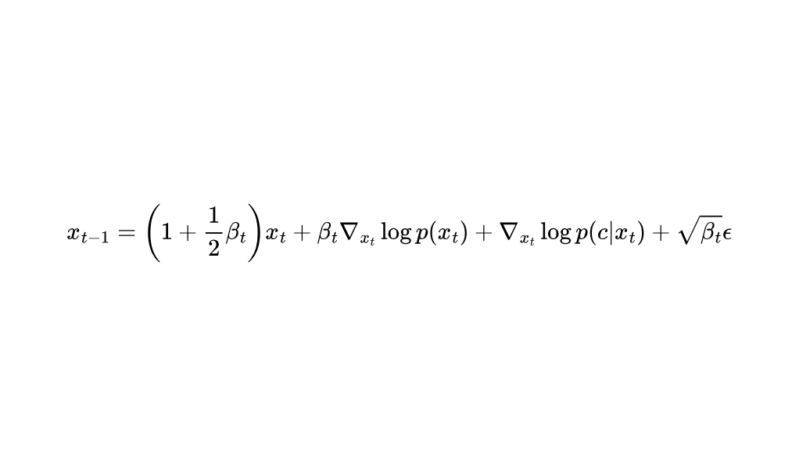
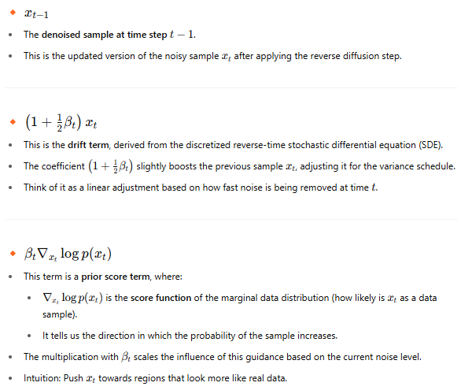
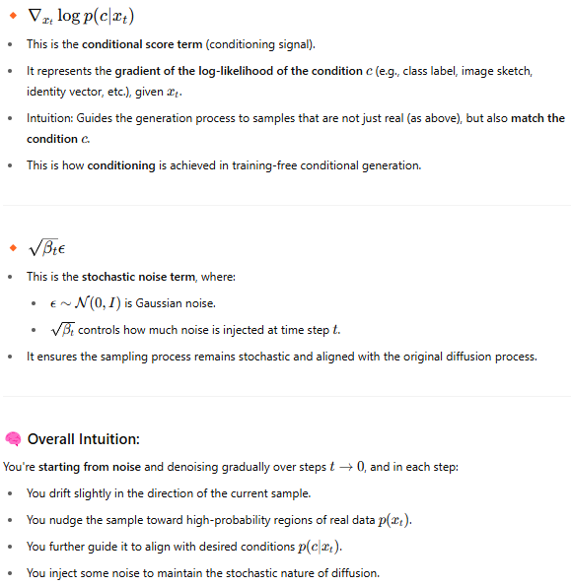
Appendix 4
Conditional Score Based Diffusion Models

Slide 60
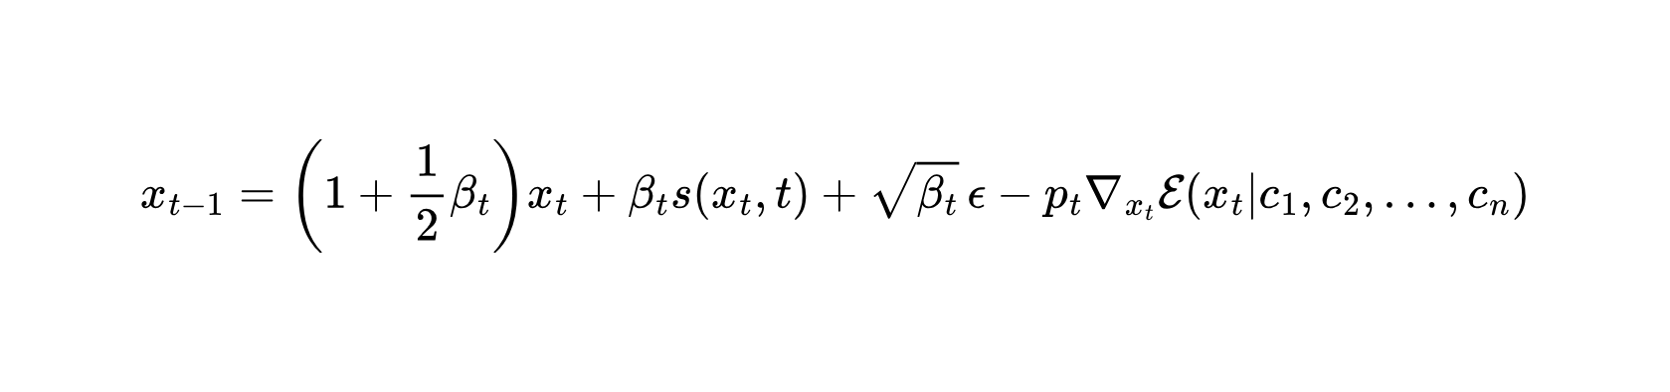
Appendix 5
Diffusion
betas = get_beta_schedule(
beta_schedule="linear",
beta_start=0.0001,
beta_end=0.02,
num_diffusion_timesteps=1000,
)

Slide 61
Appendix 5
Diffusion
betas = get_beta_schedule(
beta_schedule="linear",
beta_start=0.0001,
beta_end=0.02,
num_diffusion_timesteps=1000,
)

Slide 62
Appendix 5
Diffusion
betas = get_beta_schedule(
beta_schedule="linear",
beta_start=0.0001,
beta_end=0.02,
num_diffusion_timesteps=1000,
)

